Slide 1
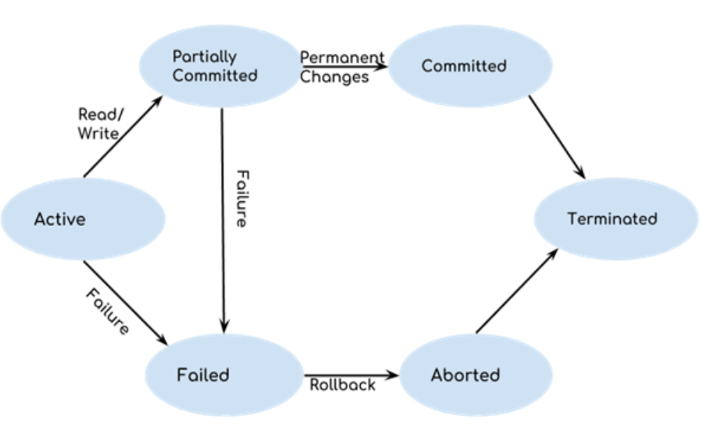
Transaction life cycle
--- MU qp
Stste transition diagram of transaction

Slide 2
Properties of transaction
--- MU qp
Atomicity
Consistency
Isolation
durability

Slide 3
Atomicity
This property ensures that either the transaction occurs completely or it does not occur at all.
In other words, it ensures that no transaction occurs partially.
That is why, it is also referred to as “All or nothing rule“.
It is the responsibility of Transaction Control Manager to ensure atomicity of the transactions.

Slide 4
consistency
This property ensures that integrity constraints are maintained.
In other words, it ensures that the database remains consistent before and after the transaction.
It is the responsibility of DBMS and application programmer to ensure consistency of the database.

Slide 5
isolation
This property ensures that multiple transactions can occur simultaneously without causing any inconsistency.
During execution, each transaction feels as if it is getting executed alone in the system.
A transaction does not realize that there are other transactions as well getting executed parallely.
Changes made by a transaction becomes visible to other transactions only after they are written in the memory.
The resultant state of the system after executing all the transactions is same as the state that would be achieved if the transactions were executed serially one after the other.
It is the responsibility of concurrency control manager to ensure isolation for all the transactions.

Slide 6
durability
This property ensures that all the changes made by a transaction after its successful execution are written successfully to the disk.
It also ensures that these changes exist permanently and are never lost even if there occurs a failure of any kind.
It is the responsibility of recovery manager to ensure durability in the database.

Slide 7
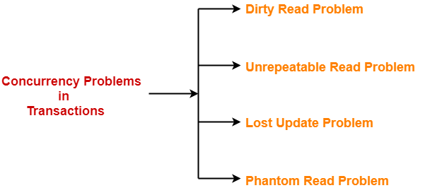
Concurrency control issues
--- MU qp
Concurrency Problems in DBMS-
When multiple transactions execute concurrently in an uncontrolled or unrestricted manner, then it might lead to several problems.
Such problems are called as concurrency problems.
Dirty Read Problem
Unrepeatable Read Problem
Lost Update Problem
Phantom Read Problem

Slide 8
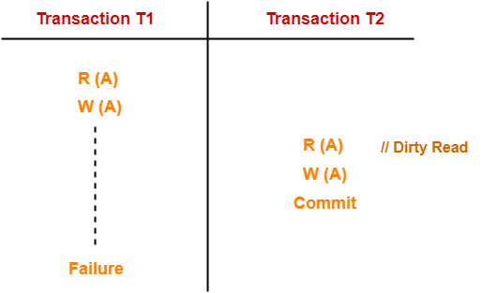
Dirty Read Problem
Reading the data written by an uncommitted transaction is called as dirty read.
This read is called as dirty read because-
There is always a chance that the uncommitted transaction might roll back later.
Thus, uncommitted transaction might make other transactions read a value that does not even exist.
This leads to inconsistency of the database.
Dirty read does not lead to inconsistency always.
It becomes problematic only when the uncommitted transaction fails and roll backs later due to some reason.
T1 reads the value of A.
T1 updates the value of A in the buffer.
T2 reads the value of A from the buffer.
T2 writes the updated the value of A.
T2 commits.
T1 fails in later stages and rolls back.
In this example,
T2 reads the dirty value of A written by the uncommitted transaction T1.
T1 fails in later stages and roll backs.
Thus, the value that T2 read now stands to be incorrect.
Therefore, database becomes inconsistent.

Slide 9
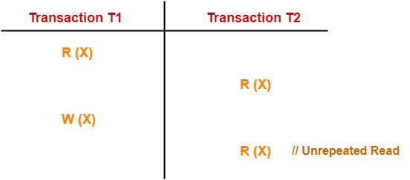
Unrepeatable Read Problem
This problem occurs when a transaction gets to read unrepeated i.e. different values of the same variable in its different read operations even when it has not updated its value.
Here,
T1 reads the value of X (= 10 say).
T2 reads the value of X (= 10).
T1 updates the value of X (from 10 to 15 say) in the buffer.
T2 again reads the value of X (but = 15).
In this example,
T2 gets to read a different value of X in its second reading.
T2 wonders how the value of X got changed because according to it, it is running in isolation.

Slide 10
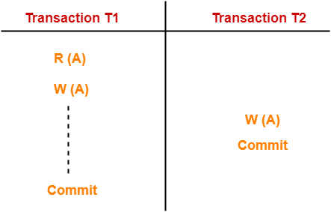
Lost Update Problem
This problem occurs when multiple transactions execute concurrently and updates from one or more transactions get lost.
T1 reads the value of A (= 10 say).
T2 updates the value to A (= 15 say) in the buffer.
T2 does blind write A = 25 (rite without read) in the buffer.
T2 commits.
When T1 commits, it writes A = 25 in the database.
In this example,
T1 writes the over written value of X in the database.
Thus, update from T1 gets lost.
This problem occurs whenever there is a write-write conflict.
In write-write conflict, there are two writes one by each transaction on the same data item without any read in the middle.

Slide 11
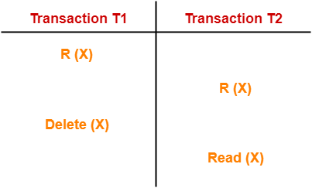
Phantom Read Problem
This problem occurs when a transaction reads some variable from the buffer and when it reads the same variable later, it finds that the variable does not exist
Here,
T1 reads X.
T2 reads X.
T1 deletes X.
T2 tries reading X but does not find it.
In this example,
T2 finds that there does not exist any variable X when it tries reading X again.
T2 wonders who deleted the variable X because according to it, it is running in isolation.

Slide 12
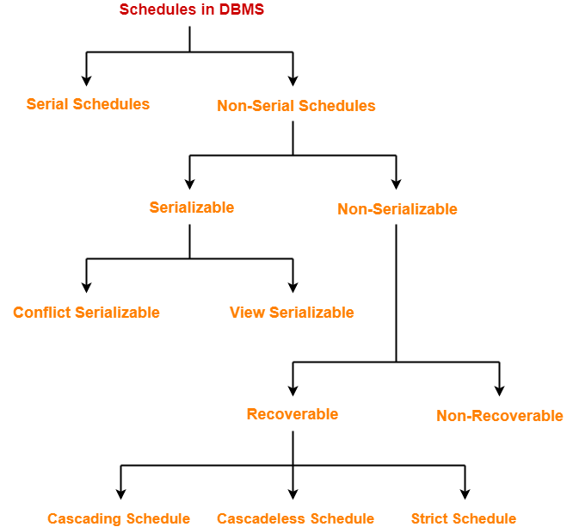
schedules
The order in which the operations of multiple transactions appear for execution is called as a schedule.
Serial schedules are always consistent.
Non-serial schedules are not always consistent.
(Types of schedules – MU QP)

Slide 13
Serializability
Some non-serial schedules may lead to inconsistency of the database.
Serializability is a concept that helps to identify which non-serial schedules are correct and will maintain the consistency of the database.
Serializable Schedule
If a given non-serial schedule of ‘n’ transactions is equivalent to some serial schedule of ‘n’ transactions, then it is called as a serializable schedule.
Serial Schedules | Serializable Schedules
No concurrency is allowed. Thus, all the transactions necessarily execute serially one after the other. | Concurrency is allowed.Thus, multiple transactions can execute concurrently.
Serial schedules lead to less resource utilization and CPU throughput. | Serializable schedules improve both resource utilization and CPU throughput.
Serial Schedules are less efficient as compared to serializable schedules.(due to above reason) | Serializable Schedules are always better than serial schedules.(due to above reason)
Serializable schedules behave exactly same as serial schedules.
Thus, serializable schedules are always-
Consistent
Recoverable
Casacadeless
Strict

Slide 14
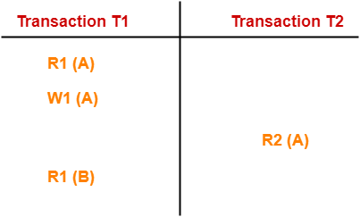
Conflict & view serializability
Conflict Serializability-
If a given non-serial schedule can be converted into a serial schedule by swapping its non-conflicting operations, then it is called as a conflict serializable schedule.
Conflicting Operations-
Two operations are called as conflicting operations if all the following conditions hold true for them-
Both the operations belong to different transactions
Both the operations are on the same data item
At least one of the two operations is a write operation
Consider the following schedule-
W1 (A) and R2 (A) are called as conflicting operations.
This is because all the above conditions hold true for them.

Slide 15
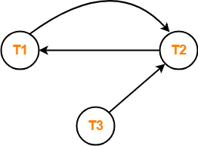
Problem-01:
Check whether the given schedule S is conflict serializable or not-
S : R₁(A) , R₂(A) , R₁(B) , R₂(B) , R₃(B) , W₁(A) , W₂(B)
Solution-
Step-01:
List all the conflicting operations and determine the dependency between the transactions-
R₂(A) , W₁(A) (T₂ → T₁)
R₁(B) , W₂(B) (T₁ → T₂)
R₃(B) , W₂(B) (T₃ → T₂)
Step-02:
Draw the precedence graph-
Clearly, there exists a cycle in the precedence graph.
Therefore, the given schedule S is not conflict serializable.

Slide 16
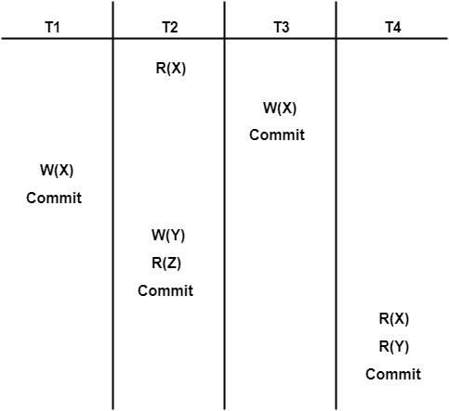
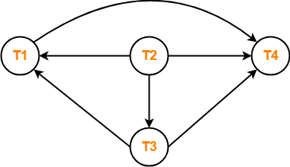
Problem-02:
Check whether the given schedule S is conflict serializable and recoverable or not-
R₂(X) , W₃(X) (T₂ → T₃)
R₂(X) , W₁(X) (T₂ → T₁)
W₃(X) , W₁(X) (T₃ → T₁)
W₃(X) , R₄(X) (T₃ → T₄)
W₁(X) , R₄(X) (T₁ → T₄)
W₂(Y) , R₄(Y) (T₂ → T₄)
Step-02:
Draw the precedence graph-
Solution-
Checking Whether S is Conflict Serializable Or Not-
Step-01:
List all the conflicting operations and determine the dependency between the transactions-
Clearly, there exists no cycle in the precedence graph.
Therefore, the given schedule S is conflict serializable.

Slide 17
View serializability
If a given schedule is found to be view equivalent to some serial schedule, then it is called as a view serializable schedule.
Two schedules are View serializable only if they satisfy following three conditions.
INITIAL READ (first read operation on a data item): if transaction T1 reads a data item X before transaction T2 in schedule S1 then in schedule S2, T1 should read X before T2.
FINAL WRITE: If data item X is last written by Transaction T1 in schedule S1 then in S2, the last write operation on X should be performed by the transaction T1.
UPDATE READ: If in schedule S1, the transaction T1 is reading a data item updated by T2 then in schedule S2, T1 should read the value after the write operation of T2 on same data item.

Slide 18
Concurrency control mechanism
Since in practice, we want concurrent (Parallel) operations on same data item are required to happen, We require to ensure that the schedules are serializable. (at least conflict serializable)
In general two protocols are proposed to ensure serializability.
2PL(Two Phase Locking) protocol
TO (Timestamp Ordering) protocol

Slide 19
Two-Phase Locking (2PL) protocol
    Guarantees serializability.
    two-phase locking protocol (2pl) if
      before operating on any object, the transaction first acquires a
      lock on that object (the growing phase)
      after releasing a lock, the transaction never acquires any more
      lock (the shrinking phase )
      i.e. In any transaction, all locks must precede all unlock.

Slide 20
2pl protocol
Ensures serializability
  Not ensures view serializability.
  Not all conflict serializable schedules are always become serializable
Due to locking (hold and wait) deadlock can occur.

Slide 21
Locking Technique: Concept (cont.)
B
X
S
A
: no lock
: request not compatible
: request compatible
X
N
N
Y
N
S
N
Y
Y
Y
Y
Y
Y
If transaction A holds a S lock on R, then
Request from B for X lock on R, => B goes into wait state
A request from B for S lock on R, => B also hold the S lock on R
Ref: X locks and S locks are normally held until the next synch point.

Slide 22
How locking solves the problems (cont.)
    The Uncommitted Dependence Problem
Transaction A time Transaction B
t1 UPDATE R R=20
(acquire X lock on R)
FETCH R t2
(request S lock on R)
wait
wait t3 synchpoint (ROLLBACK)
wait (release X lock on R) R=10
resume : FETCH R t4
(acquire S lock on R)
Transaction A is prevented from seeing an uncommitted change at time t2.

Slide 23
How locking solves the problems
    The lost Update Problem
R=10
Transaction A time Transaction B
FETCH R R=10 t1
(acquire S lock on R)
t2 FETCH R R=10
(acquire S lock on R)
UPDATE R R=10+1=11 t3
(request X lock on R)
wait
wait t4 UPDATE R R=10*2=20
wait (request X lock on R)
wait wait
wait wait
wait wait
No update is lost, but deadlock occurs at time t4.

Slide 24
Time stamp Ordering protocol
Additional overhead is required:
For each data item dbms records two timestamps other than transaction timestamp.
read_TS(X): The read timestamp of item X is the largest timestamp among all the timestamps of transactions that have successfully read item X.
  read_TS(X) = TS(T), where T is the youngest transaction that has read X successfully.
write_TS(X): The write timestamp of item X is the largest of all the timestamps of transactions that have successfully written item X.
  write_TS(X) = TS(T), where T is the youngest transaction that has written X successfully.
Basic Timestamp Ordering (TO). Whenever some transaction T tries to issue a read_item(X) or a write_item(X) operation, following conditions are checked and if are valid the T is allowed to do the operation and corresponding TS is updated with TS(T) else T is aborted and rolled back and restarted with NEW TIMESTAMP.
Note that, If, any transaction T1 that may have used a value written by T must also be rolled back. Similarly, any transaction T2 that may have used a value written by T1 must also be rolled back, and so on. This effect is known as cascading rollback and is one of the major problems associated with TO,

Slide 25
TO protocol -- rules
If T issues a write_item(X) operation,
  If read_TS(X) > TS(T) or if write_TS(X) > TS(T) is true then abort and roll back T and reject the operation.
  Else, execute the operation of T and set write_TS(X) = TS(T).
if T issues a read_item(X) operation,
  If write_TS(X) > TS(T), then abort and roll back T and reject the operation.
  If write_TS(X) ≤ TS(T), then execute the operation of T and set
  read_TS(X) = max( TS(T), current read_TS(X)).
This should be done because some younger transaction with a timestamp greater than TS(T)—and hence after T in the timestamp ordering—has already read or written the value of item X before T had a chance to write X,thus violating the timestamp ordering.
This should be done because some younger transaction with timestamp greater than TS(T)—and hence after T in the timestamp ordering—has already written the value of item X before T had a chance to read X.

Slide 26
Timestamp (cont.)
T1, t(T1)=150 T2, t(T2)=160 tr(A) tw(A) why ?
initial 0 0
(1) READ A 150 0 t(T1)=150 > tw(A)=0
(2) READ A 160 0 t(T2)=160 > tw(A)=0
(3) A:=A+1
(4) A:=A*2 t(T2)=160>=tr(A)=160
(5) WRITE A 160 160 t(T2)=160>=tw(A)=0, OK!
(6) WRITE A t(T1)=150 < tr(A), Abort!
Data A
Example
Locking?
T₁ T₂ new T₁
150 160 230
time

Slide 27
Timestamp (cont.)
Example
T1 T2 T3 Data A Data B Data C
t(T1)=200 t(T2)=150 t(T3)=175 tr(A)=0 tr(B)=0 tr(C)=0
tw(A)=0 tw(B)=0 tw(C)=0
(1) READ B tr(B)=200
(2) READ A tr(A)=150
(3) WRITE B tw(B)=200
(4) WRITE C tw(C)=150
(5) READ C tr(C)=175
(6) WRITE A tw(A)=200
(7) WRITE A 175<200
T3 abort !

Slide 28
Timestamp (cont.)
Example :Indefinite Repetition
T1 T2 T1 T2 A B
t(T1)=100 t(T2)=110 t(T1)=120 t(T1)=120 tr(A)=0 tr(B)=0
tw(A)=0 tw(B)=0
(1) WRITE B tw(B)=100
(2) WRITE A tw(A)=110
(3) READ A 100<110 ==> T1 abort !
(4) WRITE B tw(B)=120
(5) READ B 110<120, T2 abort !
(6) WRITE A tw(A)=130
(7) READ A 120<130 ==> T1 abort again !

Slide 29
deadlock
-- Uday Bhave, SAKEC

Slide 30
Deadlock Detection
The lock manager maintains a structure called a wait-for graph to periodically detect deadlocks
In a waits-for graph:
  The nodes correspond to active transactions
  There is an edge from T1 to T2 if and only if T1 is waiting for T2 to release a lock
The lock manager adds and removes edges to and from a waits-for graph when it queues and grants lock requests, respectively
A deadlock is detected when a cycle in the waits-for graph is found

Slide 31
Deadlock Detection (Cont’d)
The following schedule is free of deadlocks:
T1
T2
T3
T4
S(A)
R(A)
S(B)
X(B)
T1
T2
X(B)
W(B)
X(C)
S(C)
R(C)
T4
T3
No cycles; hence, no deadlocks!
A schedule without a deadlock
The Corresponding Wait-For Graph*
*The nodes correspond to active transactions and there is an edge from T1 to T2 if and only if T1 is waiting for T2 to release a lock

Slide 32
Deadlock Detection (Cont’d)
The following schedule is NOT free of deadlocks:
T1
T2
T3
T4
S(A)
R(A)
S(B)
X(B)
T1
T2
X(B)
W(B)
X(C)
S(C)
R(C)
X(A)
T4
T3
A schedule with a deadlock
The Corresponding Wait-For Graph*
*The nodes correspond to active transactions and there is an edge from T1 to T2 if and only if T1 is waiting for T2 to release a lock

Slide 33
Deadlock Detection (Cont’d)
The following schedule is NOT free of deadlocks:
T1
T2
T3
T4
S(A)
R(A)
S(B)
X(B)
T1
T2
X(B)
W(B)
X(C)
S(C)
R(C)
X(A)
T4
T3
Cycle detected; hence, a deadlock!
A schedule with a deadlock
The Corresponding Wait-For Graph*
*The nodes correspond to active transactions and there is an edge from T1 to T2 if and only if T1 is waiting for T2 to release a lock

Slide 34
Resolving Deadlocks
A deadlock is resolved by aborting a transaction that is on a cycle and releasing its locks
  This allows some of the waiting transactions to proceed
The choice of which transaction to abort can be made using different criteria:
  The one with the fewest locks
  Or the one that has done the least work
  Or the one that is farthest from completion (more accurate)
Caveat: a transaction that was aborted in the past, should be favored subsequently and not aborted upon a deadlock detection!

Slide 35
Deadlock Prevention
Studies indicate that deadlocks are relatively infrequent and detection-based schemes work well in practice
However, if there is a high level of contention for locks, prevention-based schemes could perform better
Deadlocks can be averted by giving each transaction a priority (in general, old transaction has higher priority)and ensuring that lower-priority transactions are not allowed to wait for higher-priority ones
(or vice versa)

Slide 36
Deadlock Prevention (Cont’d)
One way to assign priorities is to give each transaction a timestamp when it is started
  Thus, the lower the timestamp, the higher is the transaction’s priority
If a transaction T1 requests a lock and a transaction T2 holds a conflicting lock, the lock manager can use one of the following policies:
  Wound-Wait: If T1 IS OLDER, T1 WOUNDS (PREEMPTS) T2 ; otherwise (MEANS T1 IS YONGER), T1 HAS TO waits
  Wait-Die: If T1 IS OLDER, it is allowed to wait; otherwise (MEANS T1 IS YONGER), it HAS TO DIE

Slide 37
Reissuing Timestamps
A subtle point is that we must ensure that no transaction is perennially aborted because it never had a sufficiently high priority
To avoid that, when a transaction is aborted and restarted, it should be given the same timestamp it had originally
  This policy is referred to as reissuing timestamps
Reissuing timestamps ensures that each transaction will eventually become the oldest and accordingly get all the locks it requires!

Slide 38
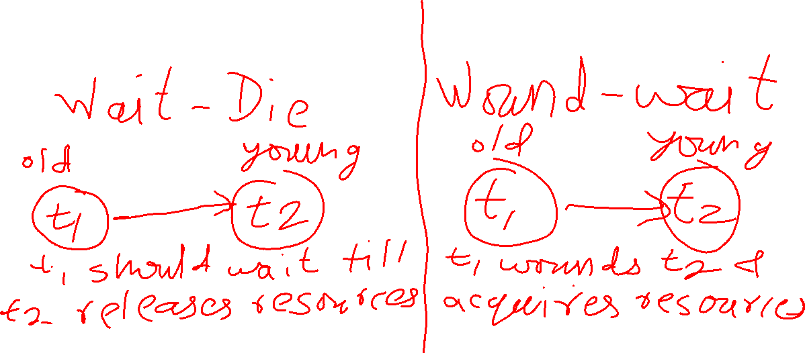
Since OLD wounds Young, It has to take re-birth with same timestamp, So eventually it will become older and so get chance to get resources.

Slide 39
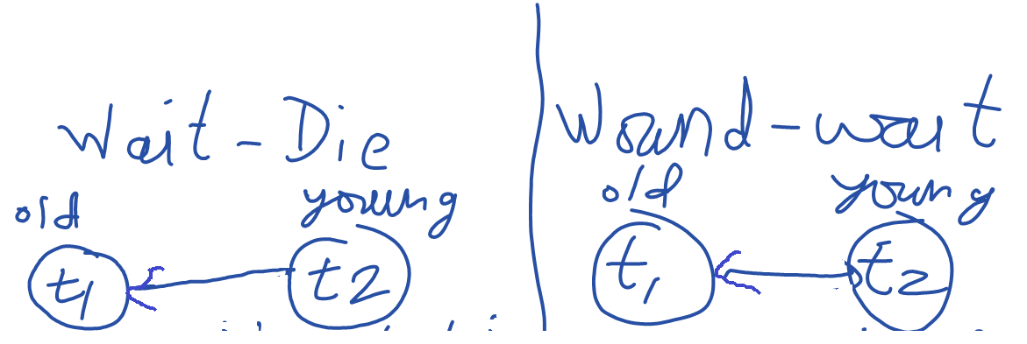
T1(old) transaction is having data, so young has to Die (suicide) and take re-birth with SAME timestamp
T1(old) transaction is having data, so young has to Wait.

Slide 40
Database recovery

Slide 41
Durability
Come what may, once transaction is committed it should be available.
Let it be a system crash, h/w failure or anything !!!!!
Seat is booked means booked.
Server failure, hard disk failed, natural disasters should not be reason for inconsistency.
Committed transaction MUST be recovered to its original state after the re-start.

Slide 42
Immediate Database Modification
The immediate database modification scheme allows database updates of an uncommitted transaction to be made as the writes are issued
  since undoing may be needed, update logs must have both old value and new value
Update log record must be written before database item is written
  We assume that the log record is output directly to stable storage
  Can be extended to postpone log record output, so long as prior to execution of an output(B) operation for a data block B, all log records corresponding to items B must be flushed to stable storage
Output of updated blocks can take place at any time before or after transaction commit
Order in which blocks are output can be different from the order in which they are written.

Slide 43
Immediate Database Modification Example
Log Write Output
<T₀ start>
<T₀, A, 1000, 950>
T_{o}, B, 2000, 2050
A = 950
B = 2050
<T₀ commit>
<T₁ start>
<T₁, C, 700, 600>
C = 600
<T₁ commit>
B_{A}
Note: B_{X} denotes block containing X.

Slide 44
Immediate Database Modification (Cont.)
Recovery procedure has two operations instead of one:
  undo(T1) restores the value of all data items updated by T1 to their old values, going backwards from the last log record for T1
  redo(T1) sets the value of all data items updated by T1 to the new values, going forward from the first log record for T1
Both operations must be idempotent
  That is, even if the operation is executed multiple times the effect is the same as if it is executed once
    Needed since operations may get re-executed during recovery
When recovering after failure:
  Transaction T1 needs to be undone if the log contains the record
  <T1 start>, but does not contain the record <T1 commit>.
  Transaction T1 needs to be redone if the log contains both the record <T1 start> and the record <T1 commit>.
Undo operations are performed first, then redo operations.
(undo(undo(x))= undo(x)

Slide 45
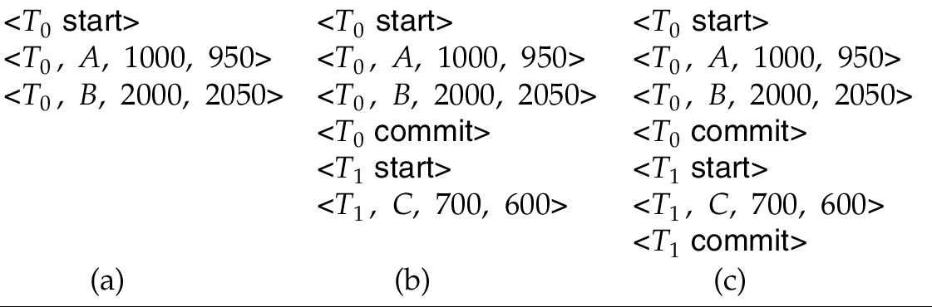
Immediate DB Modification Recovery Example
Below we show the log as it appears at three instances of time.
Recovery actions in each case above are:
(a) undo (T₀): B is restored to 2000 and A to 1000.
(b) undo (T₁) and redo (T₀): C is restored to 700, and then A and B are
set to 950 and 2050 respectively.
(c) redo (T₀) and redo (T₁): A and B are set to 950 and 2050
respectively. Then C is set to 600

Slide 46
Deferred Database Modification
The deferred database modification scheme records all modifications to the log, but defers all the writes to after partial commit.
Assume that transactions execute serially
Transaction starts by writing <T1 start> record to log.
A write(X) operation results in a log record <T1, X, V> being written, where V is the new value for X
  Note: old value is not needed for this scheme
The write is not performed on X at this time, but is deferred.
When T1 partially commits, <T1 commit> is written to the log
Finally, the log records are read and used to actually execute the previously deferred writes.

Slide 47
Deferred Database Modification (Cont.)
During recovery after a crash, a transaction needs to be redone if and only if both <T1 start> and<T1 commit> are there in the log.
Redoing a transaction T1 ( redoT_{i}) sets the value of all data items updated by the transaction to the new values.
Crashes can occur while
  the transaction is executing the original updates, or
  while recovery action is being taken
example transactions T₀ and T₁ (T₀ executes before T₁):
T₀: read (A) T₁ : read (C)
A: - A - 50 C:- C- 100
Write (A) write (C)
read (B)
B:- B + 50
write (B)

Slide 48
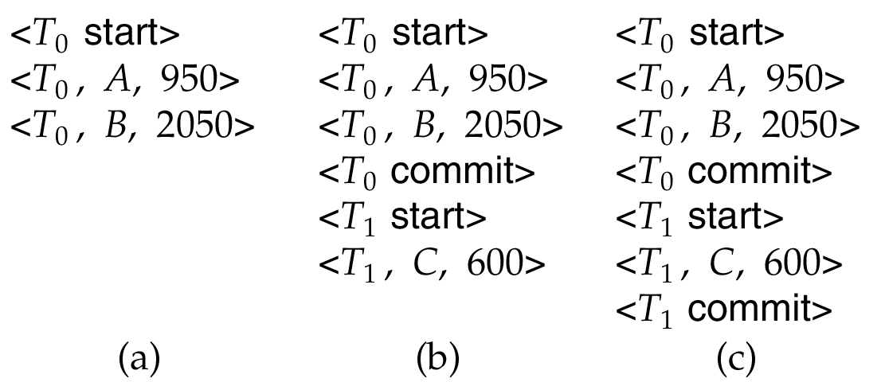
Deferred Database Modification (Cont.)
Below we show the log as it appears at three instances of time.
If log on stable storage at time of crash is as in case:
(a) No redo actions need to be taken
(b) redo(T₀) must be performed since <T₀ commit> is present
(c) redo(T₀) must be performed followed by redo(T₁) since
<T₀ commit> and <T1 commit> are present

Slide 49
Deferred Database Modification
The deferred database modification scheme records all modifications to the log, but defers all the writes to after partial commit.
Assume that transactions execute serially
Transaction starts by writing <T1 start> record to log.
A write(X) operation results in a log record <T1, X, V> being written, where V is the new value for X
  Note: old value is not needed for this scheme
The write is not performed on X at this time, but is deferred.
When T1 partially commits, <T1 commit> is written to the log
Finally, the log records are read and used to actually execute the previously deferred writes.

Slide 50
Deferred Database Modification (Cont.)
During recovery after a crash, a transaction needs to be redone if and only if both <T1 start> and<T1 commit> are there in the log.
Redoing a transaction T1 ( redoT_{i}) sets the value of all data items updated by the transaction to the new values.
Crashes can occur while
  the transaction is executing the original updates, or
  while recovery action is being taken
example transactions T₀ and T₁ (T₀ executes before T₁):
T₀: read (A) T₁ : read (C)
A: - A - 50 C:- C- 100
Write (A) write (C)
read (B)
B:- B + 50
write (B)

Slide 51
Deferred Database Modification (Cont.)
Below we show the log as it appears at three instances of time.
If log on stable storage at time of crash is as in case:
(a) No redo actions need to be taken
(b) redo(T₀) must be performed since <T₀ commit> is present
(c) redo(T₀) must be performed followed by redo(T₁) since
<T₀ commit> and <T1 commit> are present

